Slide 1
NWEN 304
GROUP PROJECT
By Darren Tong, Minping Yang, Tabitha Byrne

Slide 2
What we have done so far
Done all requirements in basic, completion and challenge, except use of caching related HTTP headers.

Slide 3
The distribution of each group members so far
Darren has done the front-end design on the web application, designed the database, created the pages for the categories of the items, the add to cart function for the items, the view cart page, the orders page, the administrator account to modify all orders, and the recommendation page.

Slide 4
The distribution of each group members so far
Minping has done Implement basic user registration functionality, implement basic user login / logout functionality, host your server successfully on Heroku, use OAuth and Google Identity Platform for user registration and authentication, proper implementation of salted password hashing in the web server for secure user account management, implement a simple user password reset function through a web-based interface, designed and implemented with clear consideration of the privacy aspect, support a timeout function: when user stop using the application for a certain period of time, and evaluate and measure the performance of our server application, implement email loop for password reset.

Slide 5
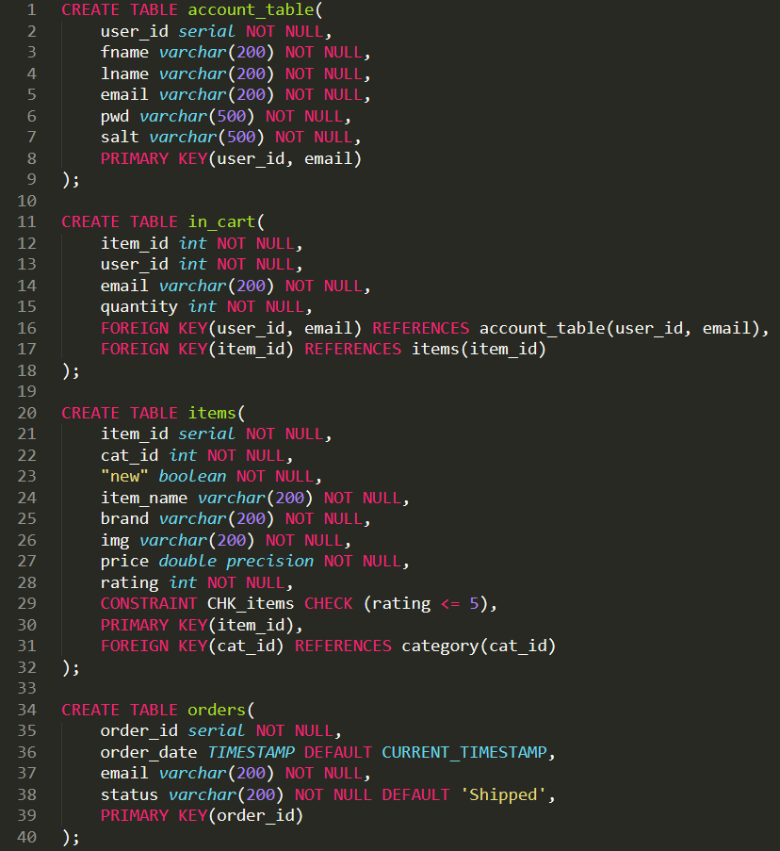
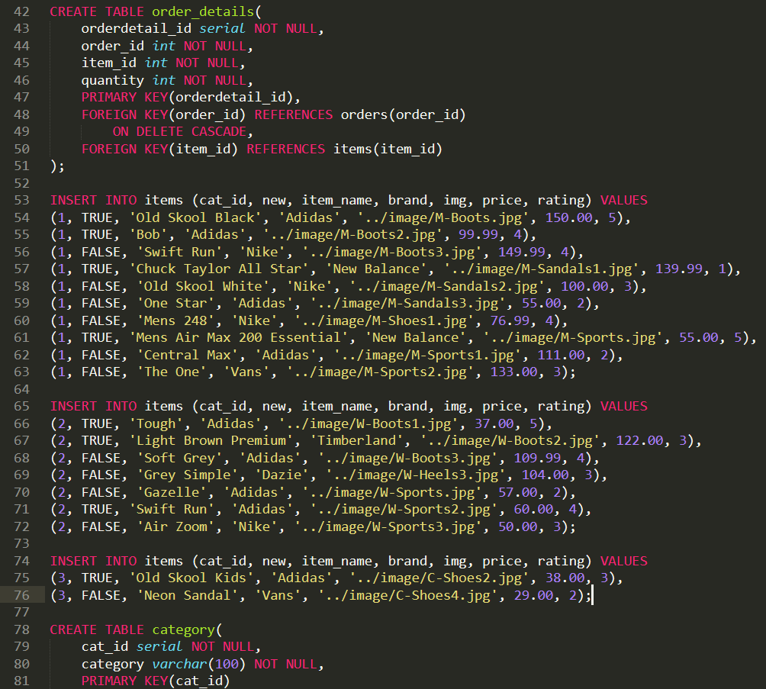
Database

Slide 6
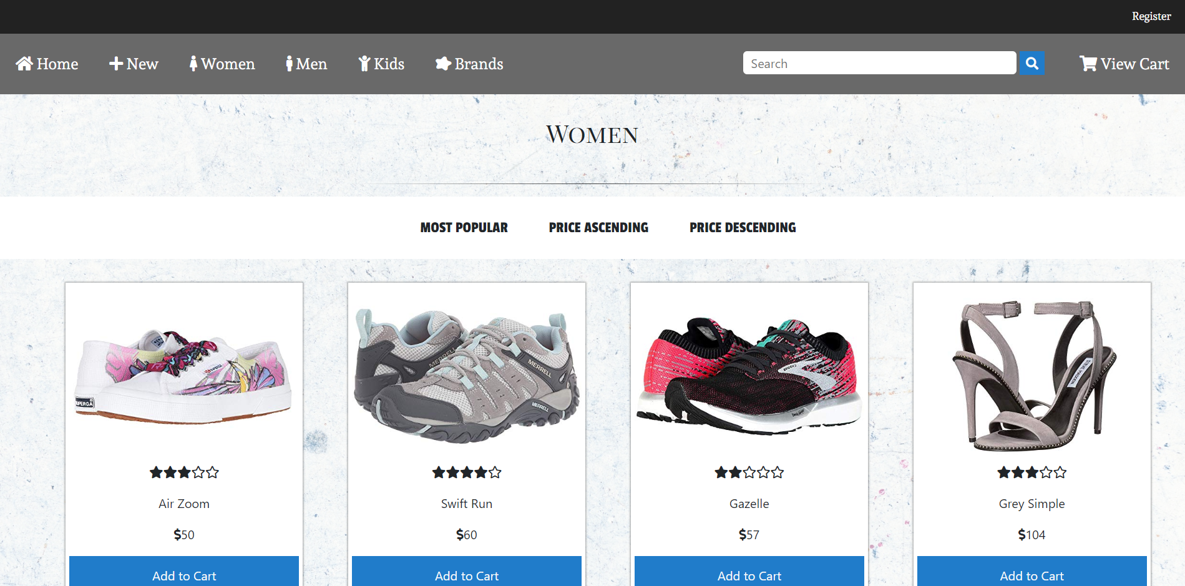

Slide 7
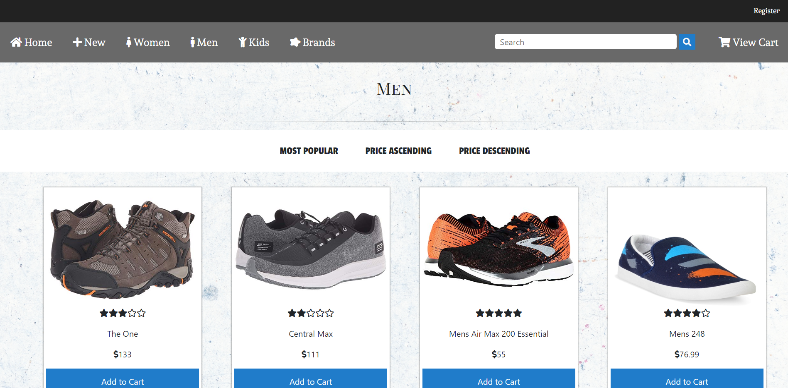

Slide 8
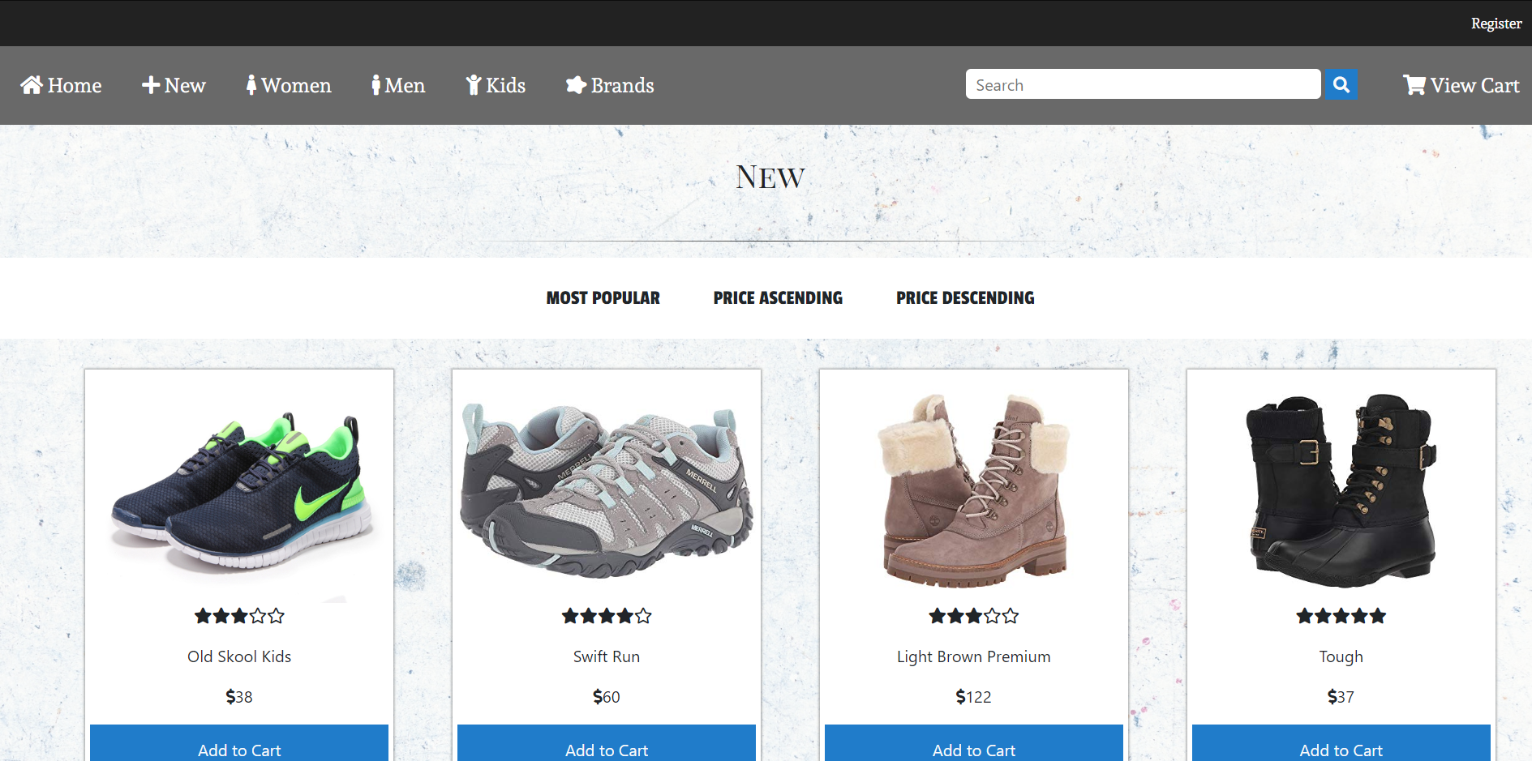

Slide 9
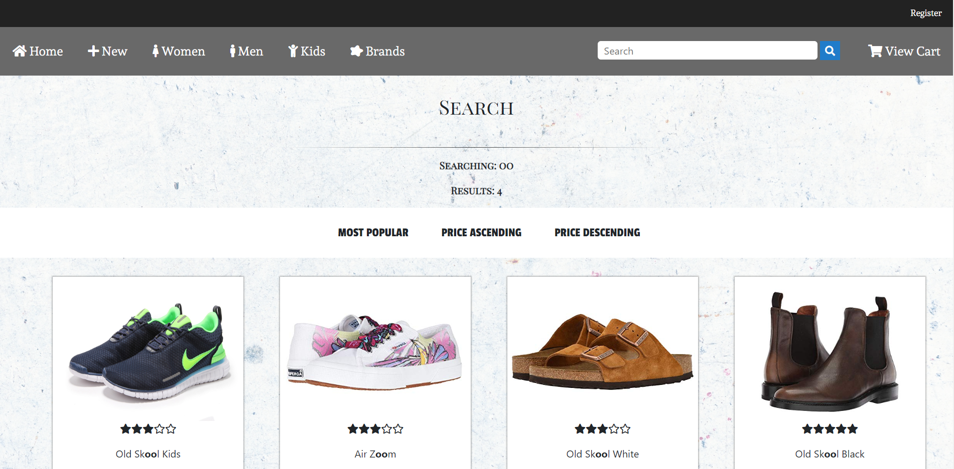
Search

Slide 10
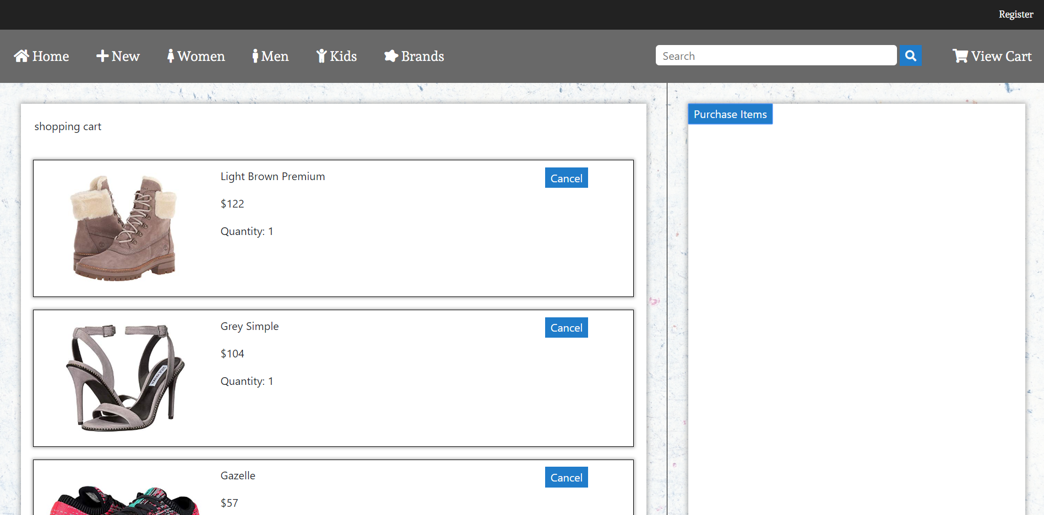
View Cart

Slide 11
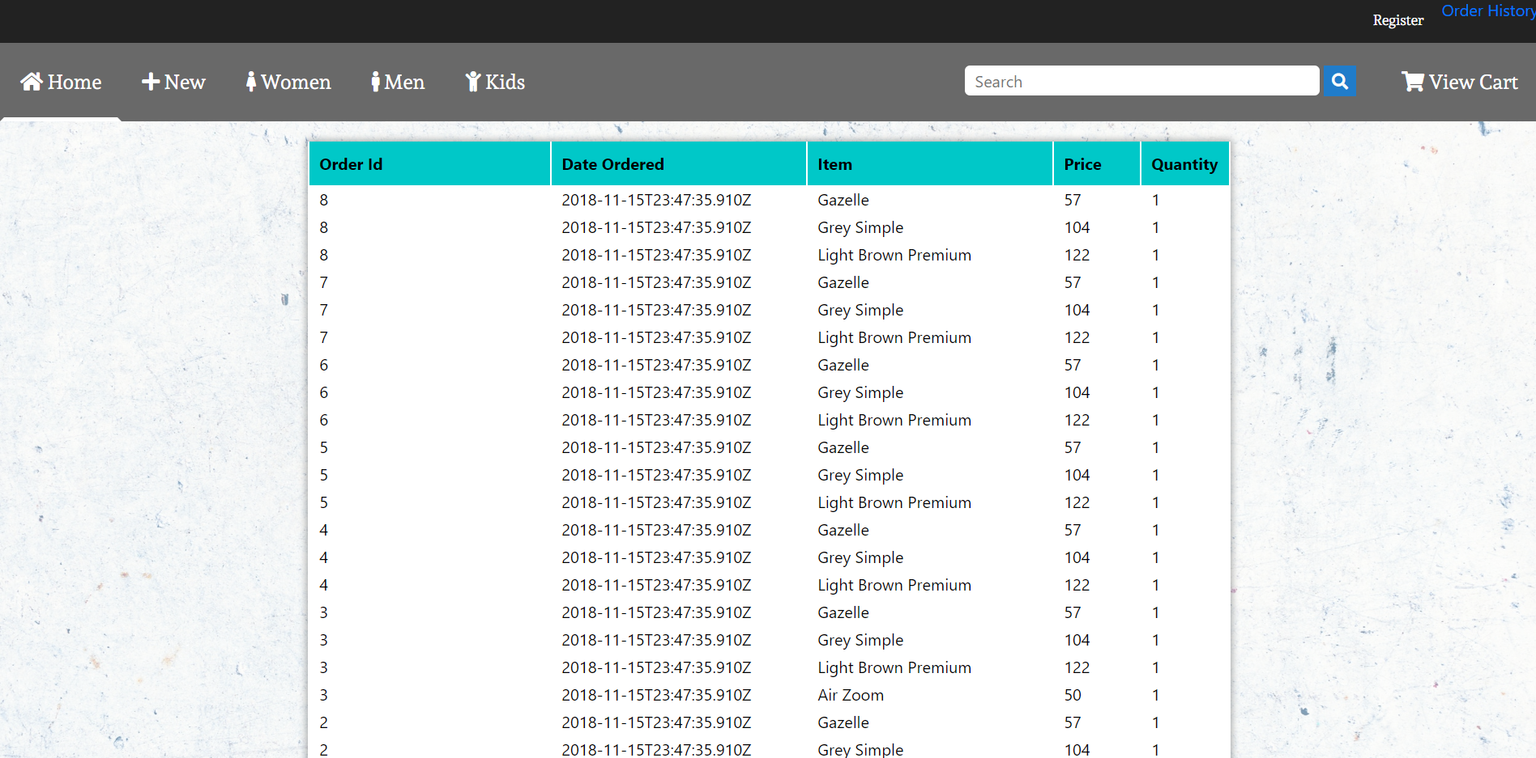
Order History

Slide 12
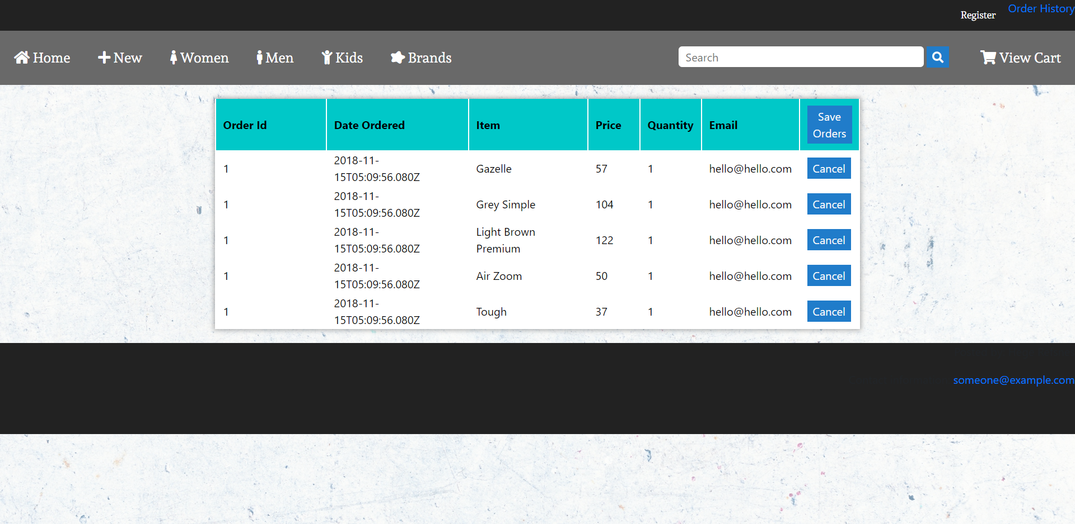
Administrator User Order Modifications

Slide 13
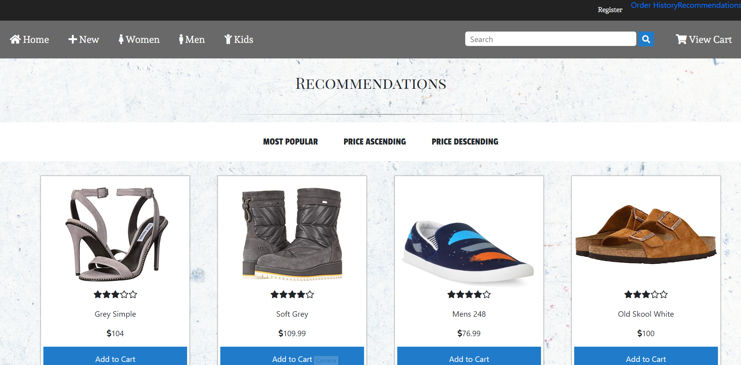
Recommendation

Slide 14
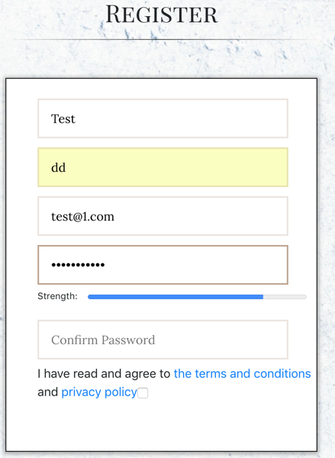
Basic user registration functionality

Slide 15
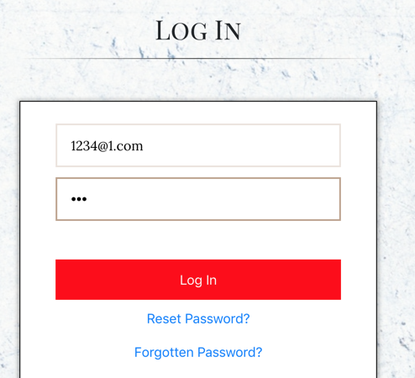
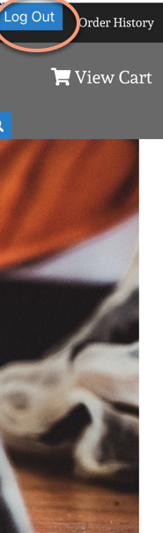
implement basic user login / logout functionality

Slide 16
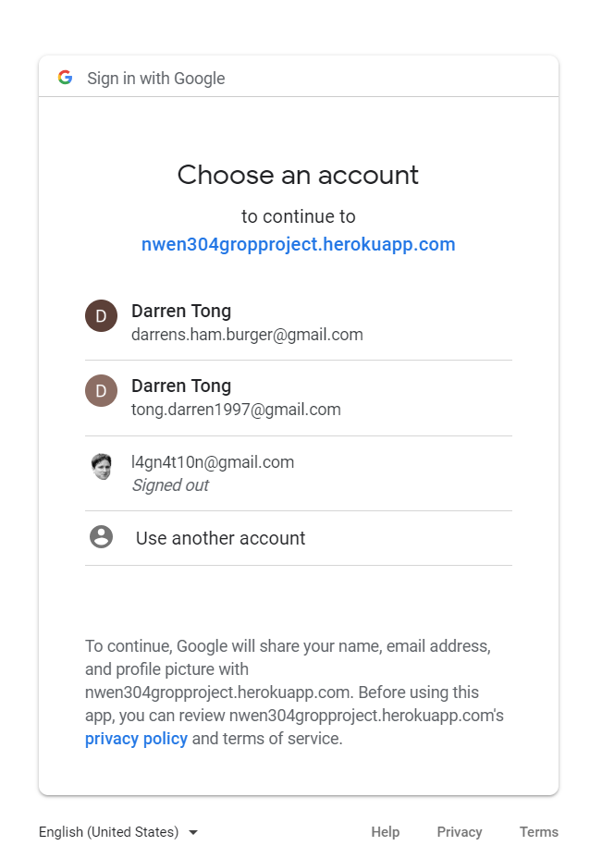
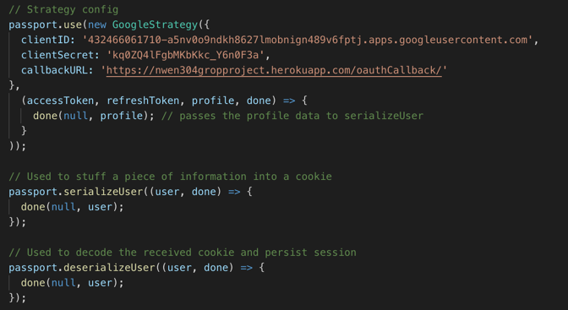
use OAuth and Google Identity Platform for user registration and authentication

Slide 17
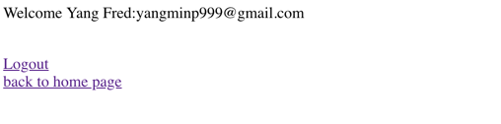
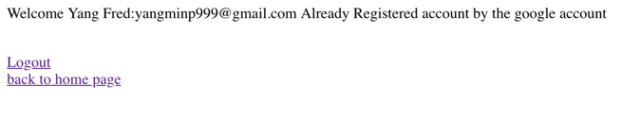
Passed authentication of Google Identity Platform
Gmail account
PWD:123456

Slide 18
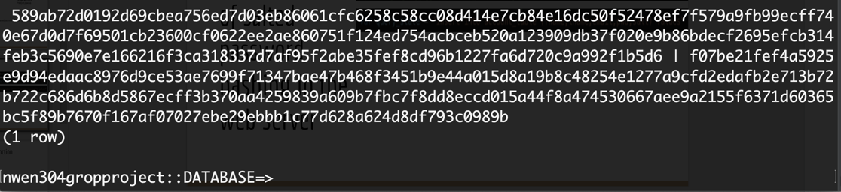
implementation of salted password hashing in the web server

Slide 19
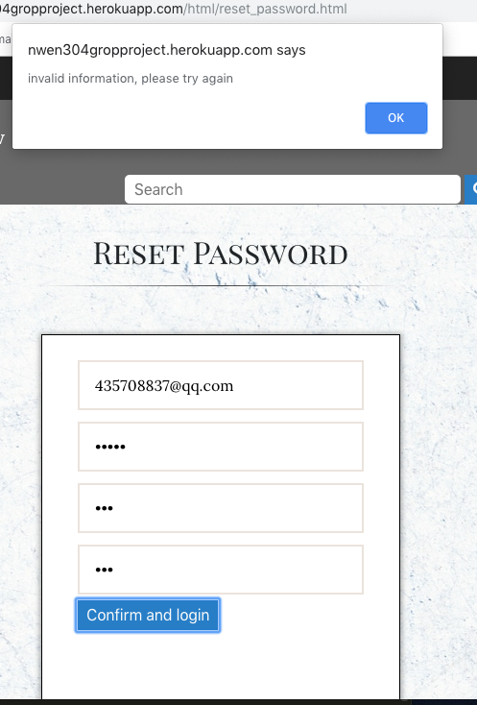
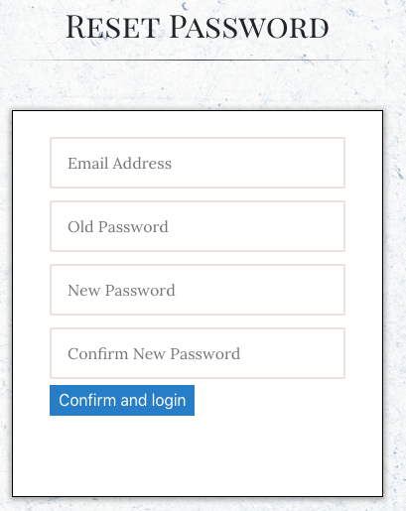
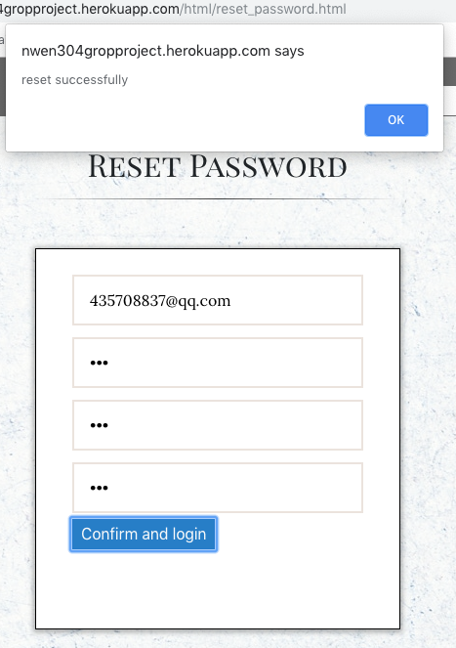
a simple user password reset function

Slide 20
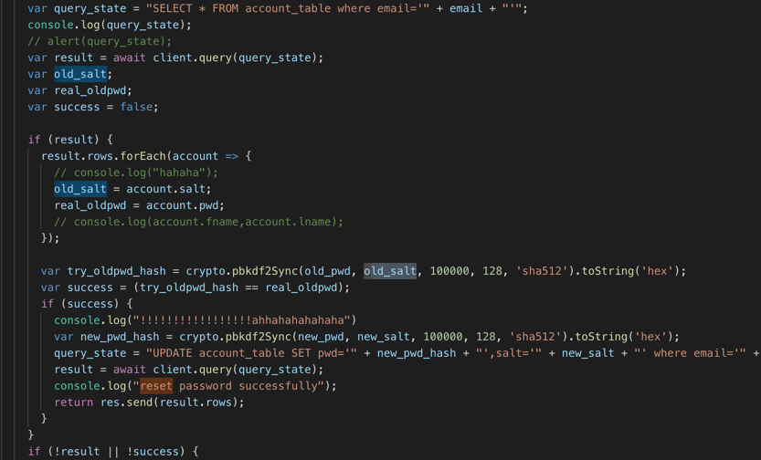
Reset Password back-end

Slide 21
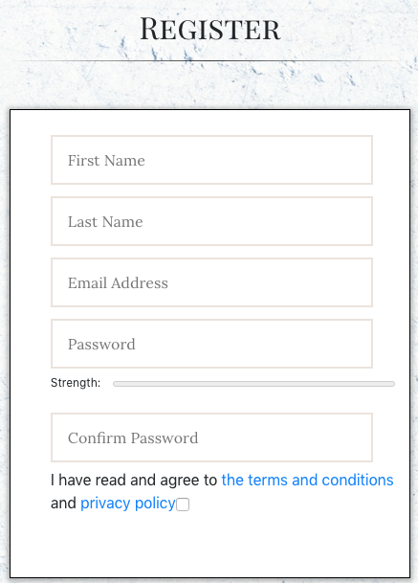
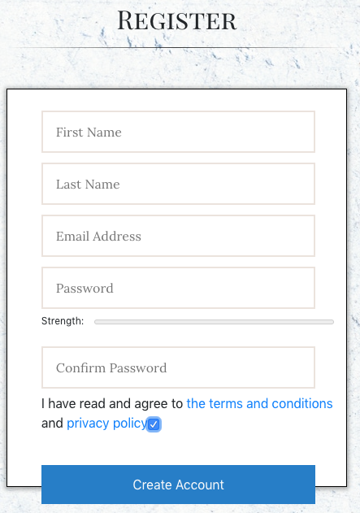
Designed and implemented with clear consideration of the privacy aspect

Slide 22
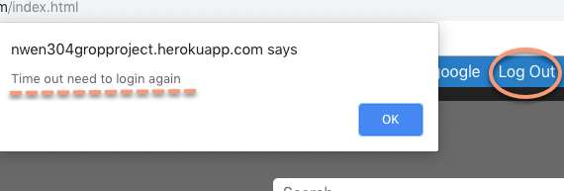
a timeout function: when user stop using the application for a certain period of time

Slide 23
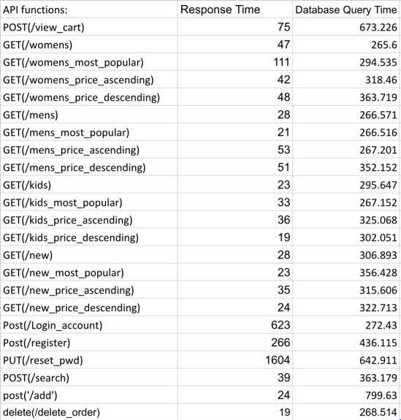
measure the performance of our server application

Slide 24
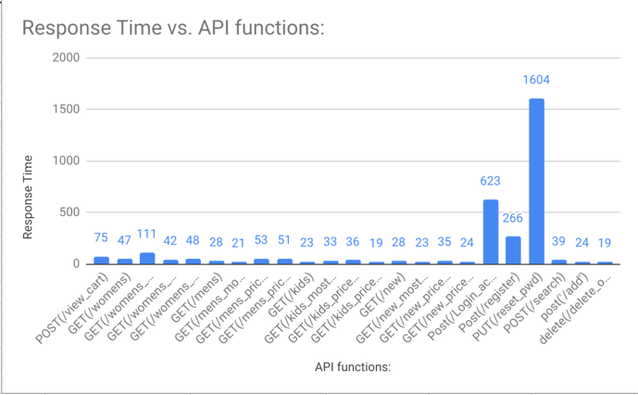
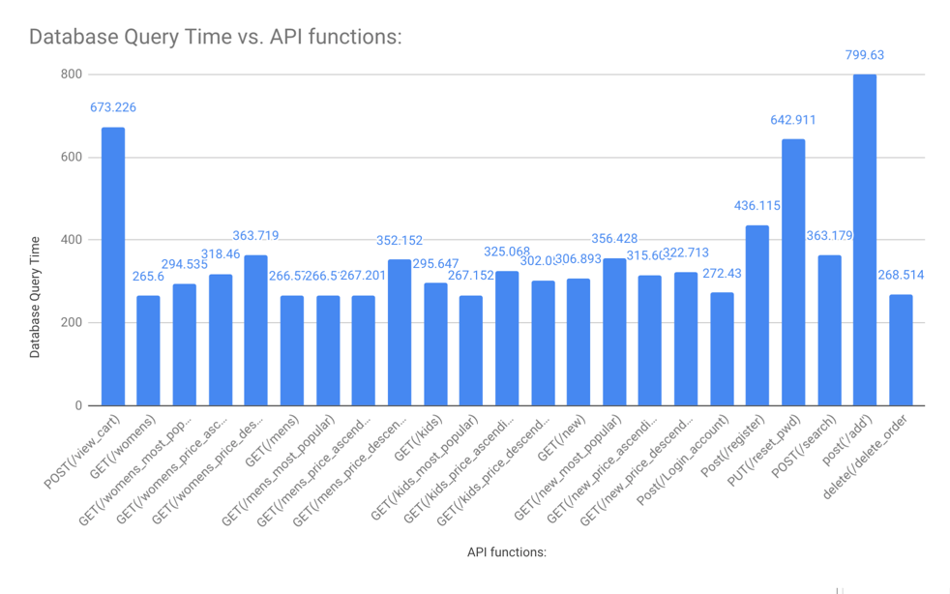
Bar Charts
Notes:
Determine whether the database stands for a performance bottleneck of your web application.
Add more data

Slide 25
Determine whether the database stands for a performance bottleneck of your web application.
CREATE INDEX id2 ON customer (customerid,l_name,f_name,city,no_borrowed);
Indexes are used to find rows with specific column values quickly. Without an index, SQL must begin with the first row and then read through the entire table to find the relevant rows. The larger the table, the more this costs. If the table has an index for the columns in question, SQL can quickly determine the position to seek to in the middle of the data file without having to look at all the data. This is much faster than reading every row sequentially.

Slide 26
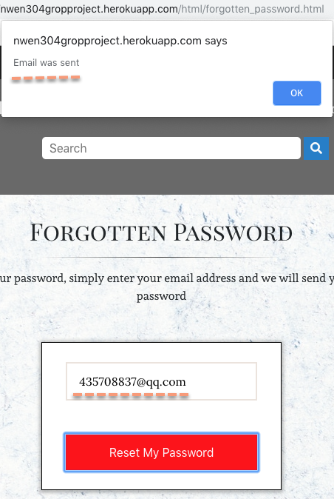
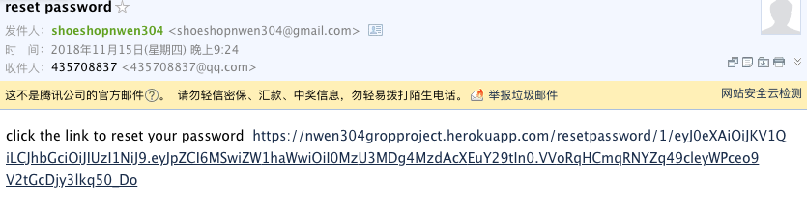
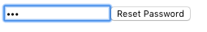
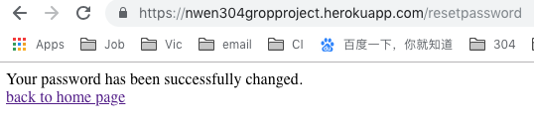
implement email loop for password reset

Slide 27
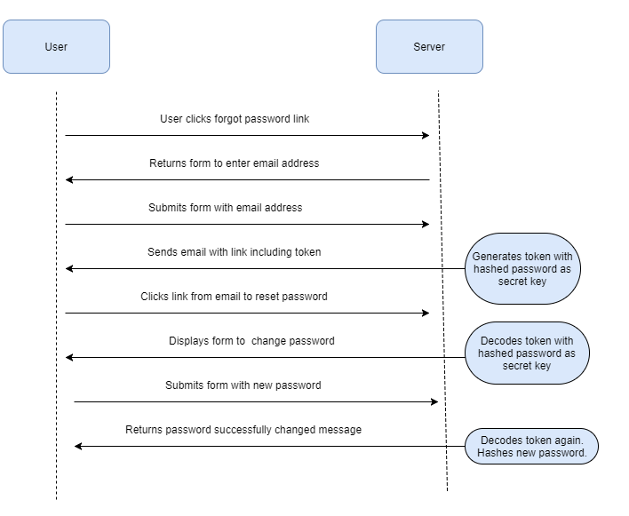
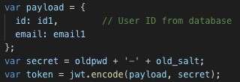
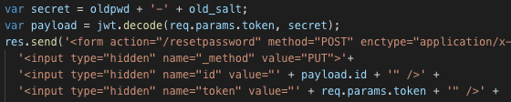
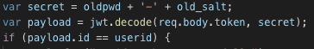
A JSON Web Token (JWT)

